Slide 1
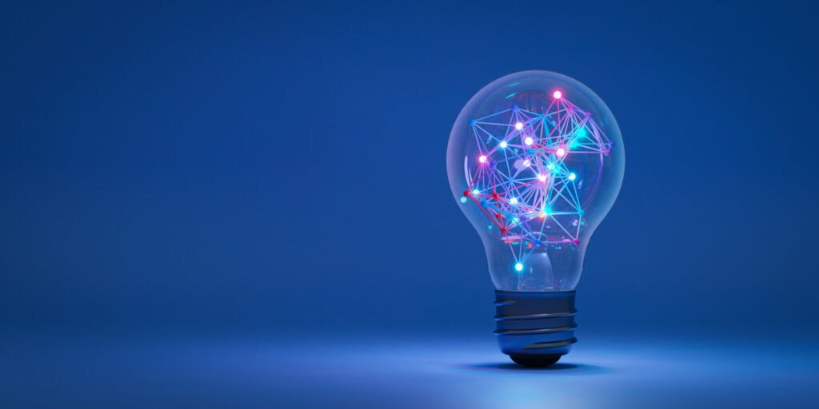
HISTORY OF ARTIFICIAL INTELIGENCE : FROM DREAMS TO REALITY
Prepared By- Anshuman Tiwari
M.Sc. Mathematics with AI & Data Science

Slide 2
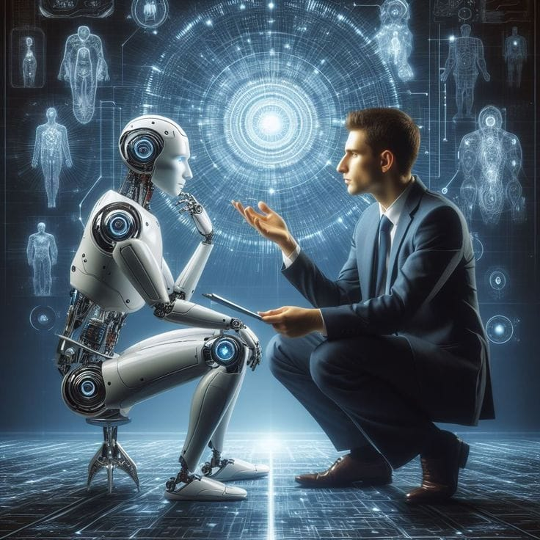
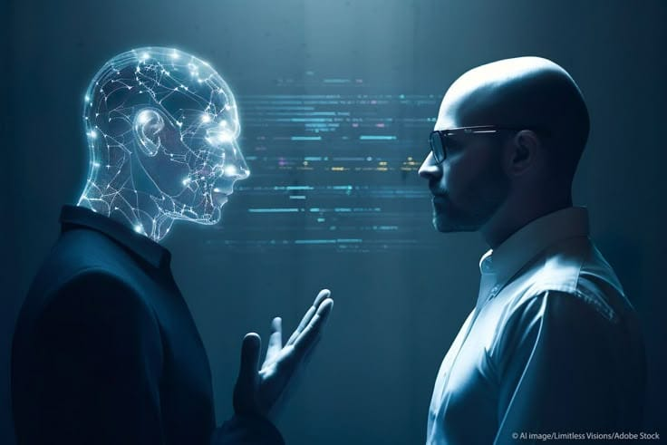
AI ONLY A DREAM ?
“Can machines thinks like humans?”
“ Imagine waking up and your phone already knows your mood…”
“ A machine suggests your food, music, and even decisions…”
“ Are we creating our future… or our replacement?”
“These questions started the journey of AI…"

Slide 3
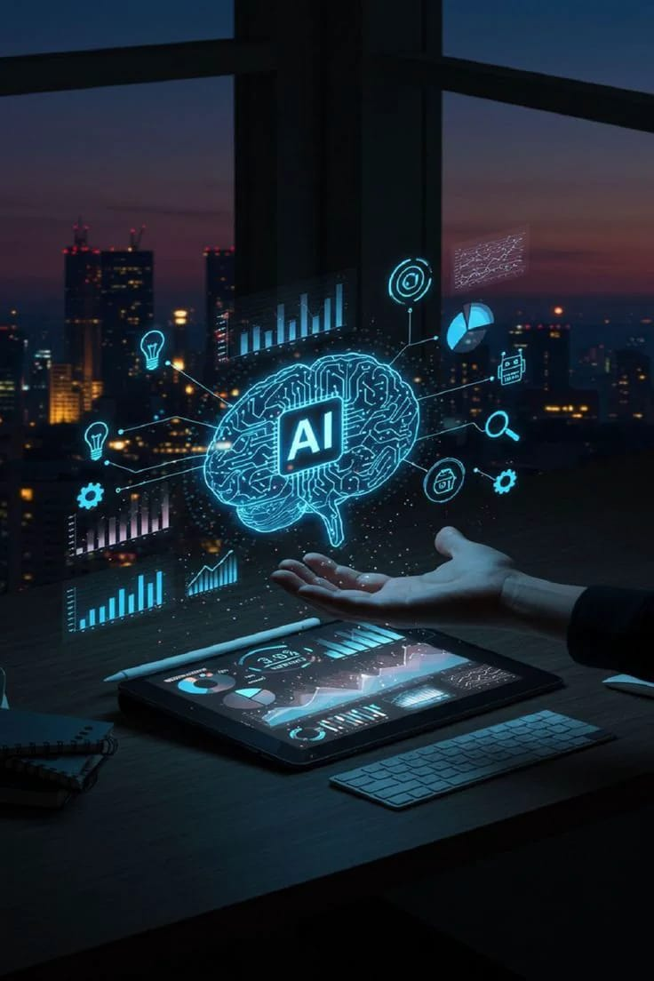
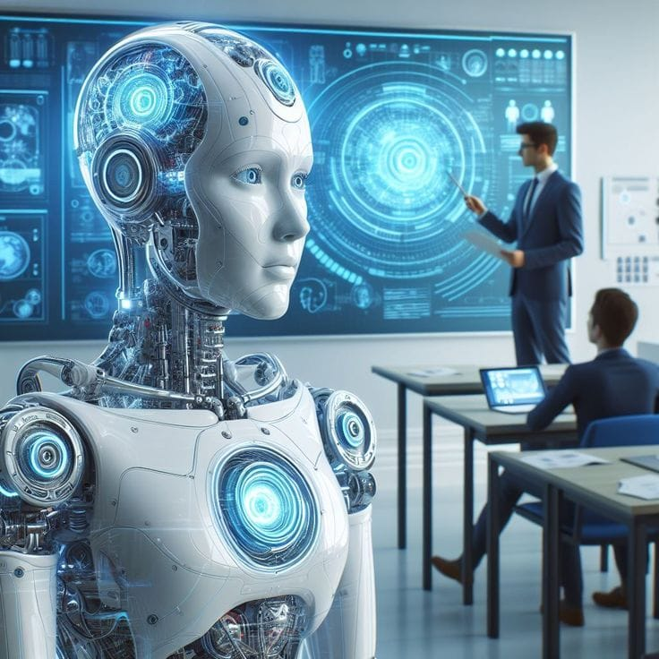
What is AI?
AI = Machines that can learn, think and decide. It refers to the ability of machines to mimic human intelligence and perform tasks that typically require human cognition.
Examples:-Google maps, chatbots, face recognition etc….
“AI is not future, it’s already here.”

Slide 4
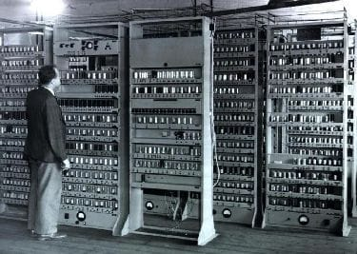
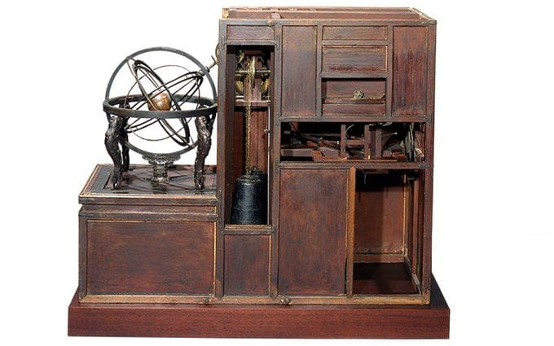
Early Ideas(Before Computers)
Humans always dreamed of Artificial beings
Greek myths: Robots like Talos
Leonardo da Vinci designed mechanical robots (1495)
IDEA: “Can we create life artificially?”
EDSAC
HONCHEONSIGYE

Slide 5
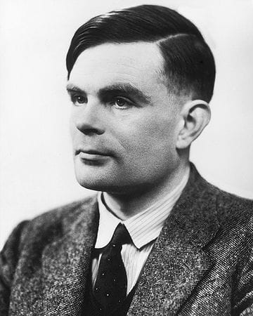
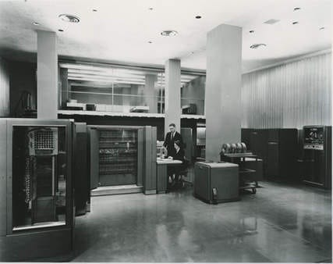
BIRTH OF AI (1950s)
Alan Turin proposed Turing Test to evaluate machine intelligence.
The term artificial intelligence was coined by John McCarthy.
The famous Dartmouth Conference (1956) marked the official birth of AI.
AI programs like ELIZA simulated human conversation.
Scientists believed : “AI will be ready in 20 years and soon thinks like humans.”
ALAN TURING
IBM 704 EDPS

Slide 6
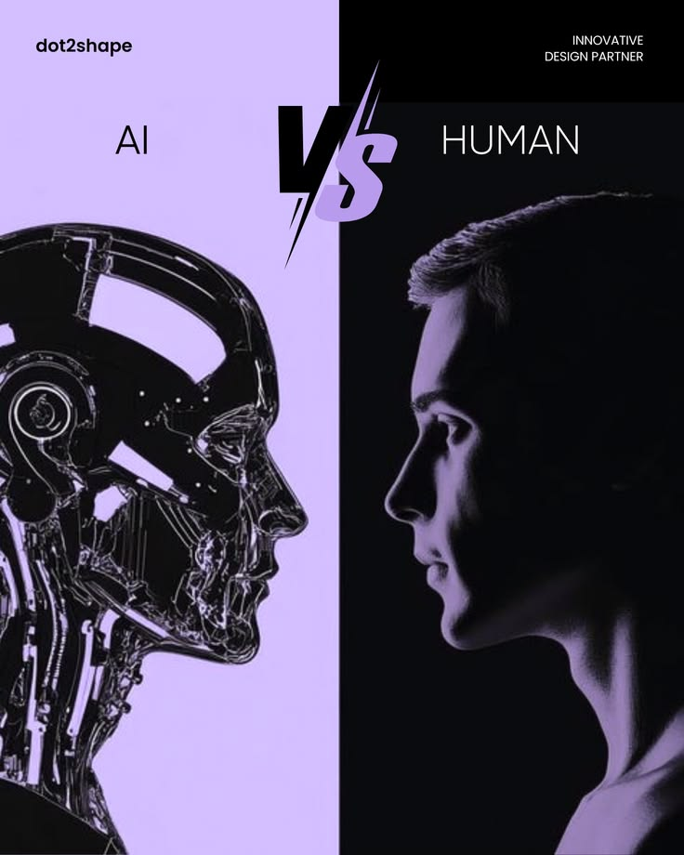
AI WINTER (1970s-1990s)
AI failed to meet expectations.
Lack of data and computing power
Funding reduced
Computers were not powerful enough
AI progress slowed down
Scientists believed: “AI is not future, it’s ends here.”

Slide 7
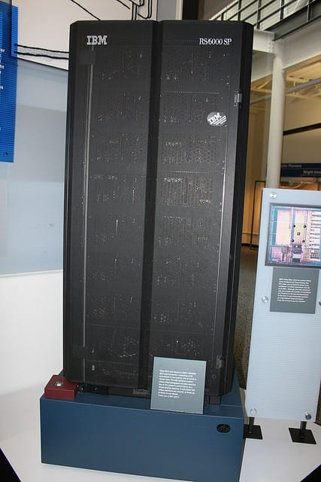
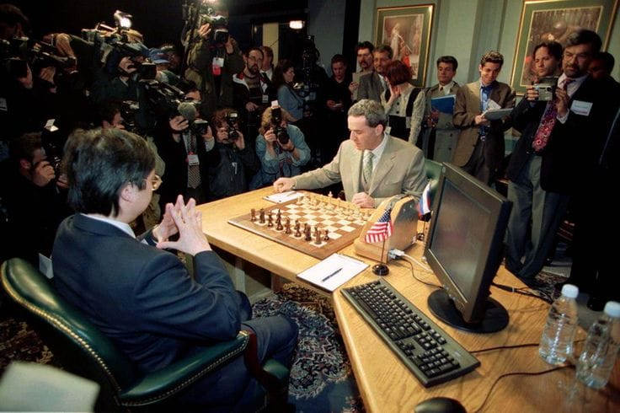
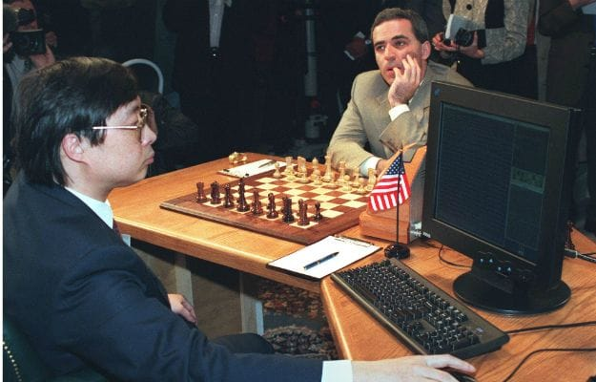
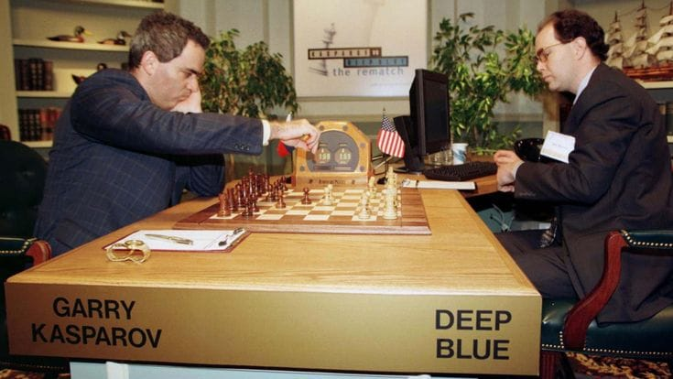
AI COMEBACK (1997)
IBM DEEP BLUE defeated Garry Kasparov in Chess match
First major success of AI
First time machine beat world champion
Scientists believed: “ The historical comeback of machine.”
MACHINE LEARNING ERA…
IBM DEEP BLUE VS Garry Kasparov

Slide 8
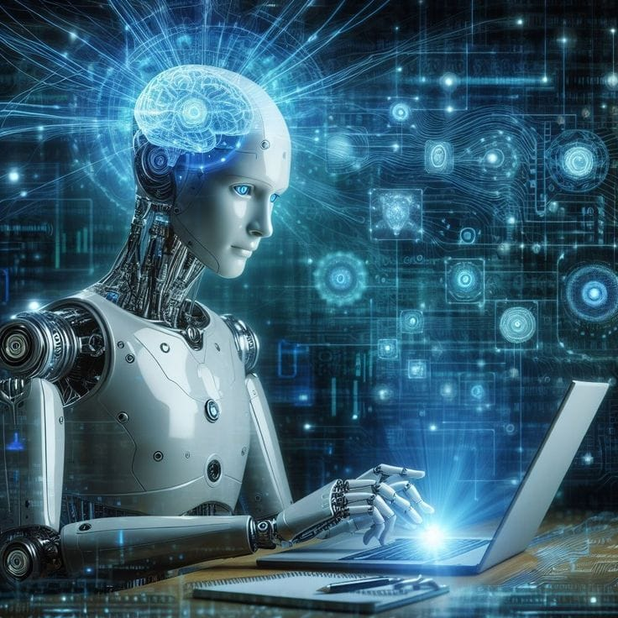
RISE OF MODERN AI (2000-2015)
Growth of Internet and Big Data
Development of Machine Learning
IBM Watson wins Jeopardy (2011)
GPUs accelerate training
Large Scale Deep Learning
AI used in:
- Google search
- Recommendation Systems
Scientists believed: “AI is present, AI is future.”

Slide 9
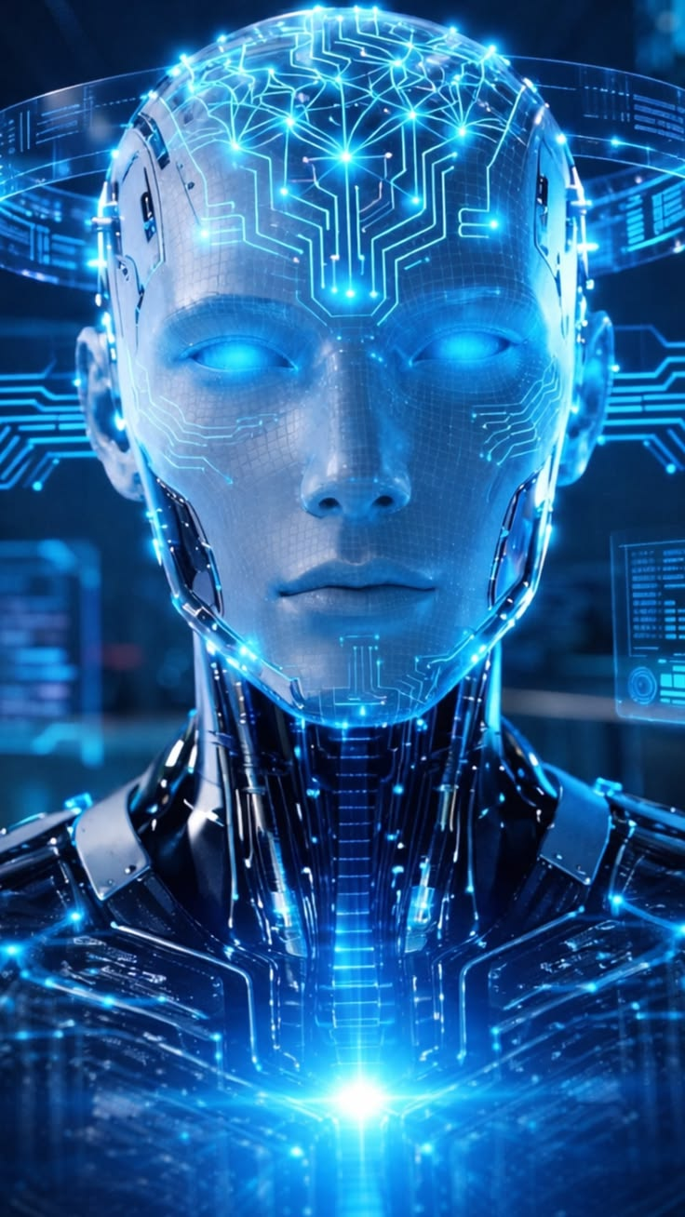
DEEP LEARNING ERA (2015-Present)
AlphaGo beats Lee Sedol
Large Language Models used (LLMs)
Neural networks
Self driving cars (Tesla , Byd)
Voice assistance
Chatbots like Chat GPT (launches on 2022), Gemini, Claoud.
AI now can:
- Speak
- Write
- Create images
Scientists believed: “ AI is very useful and growing fast, but it’s not yet as intelligent as humans and must be developed carefully.”
AI IS POWERFUL BUT NARROW…

Slide 10
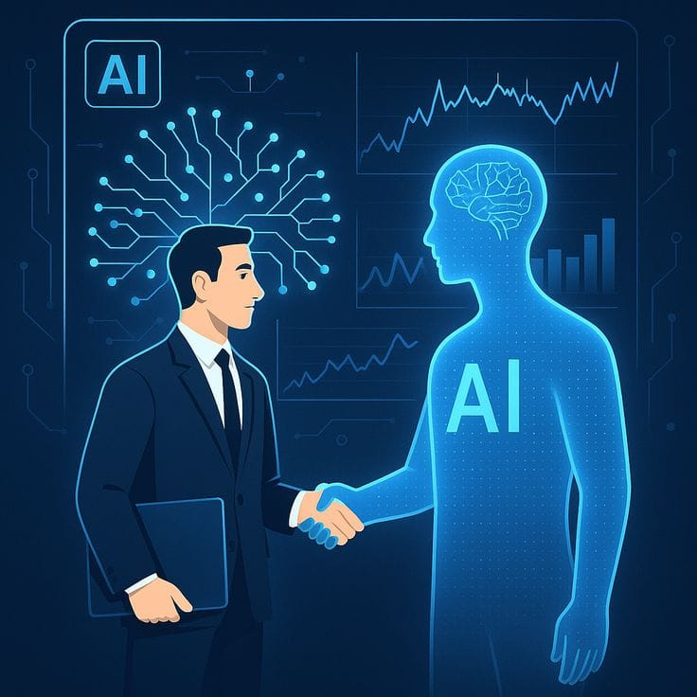
FUTURE OF AI
Artificial General Intelligence (AGI)
Self Learning System
Human- AI Collaboration
Super AI (Machines smarter than humans?)
AI will used in:
- Health care
- Education
- Space
Scientists questioned: “Will AI help humans or replace them?”

Slide 11



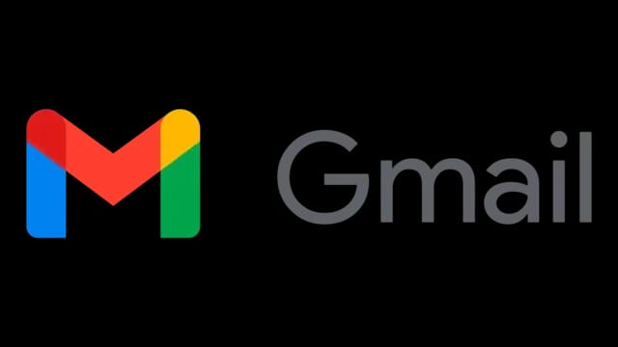

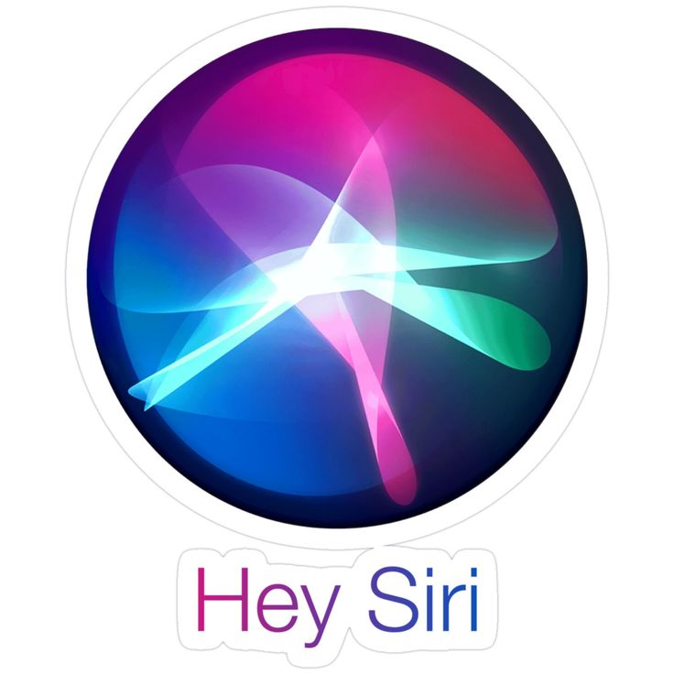


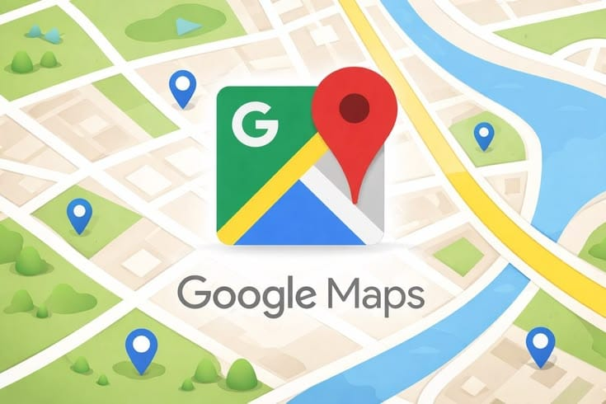
REAL LIFE TOOLS OF AI
Google Maps
Chat GPT
You tube
Netflix
Amazon
Instagram
LinkedIn
Spotify
Gmail
Face Unlock
Siri
Swiggy
Uber
UP fraud Detection
Banking
Healthcare
ISRO Satellite images

Slide 12
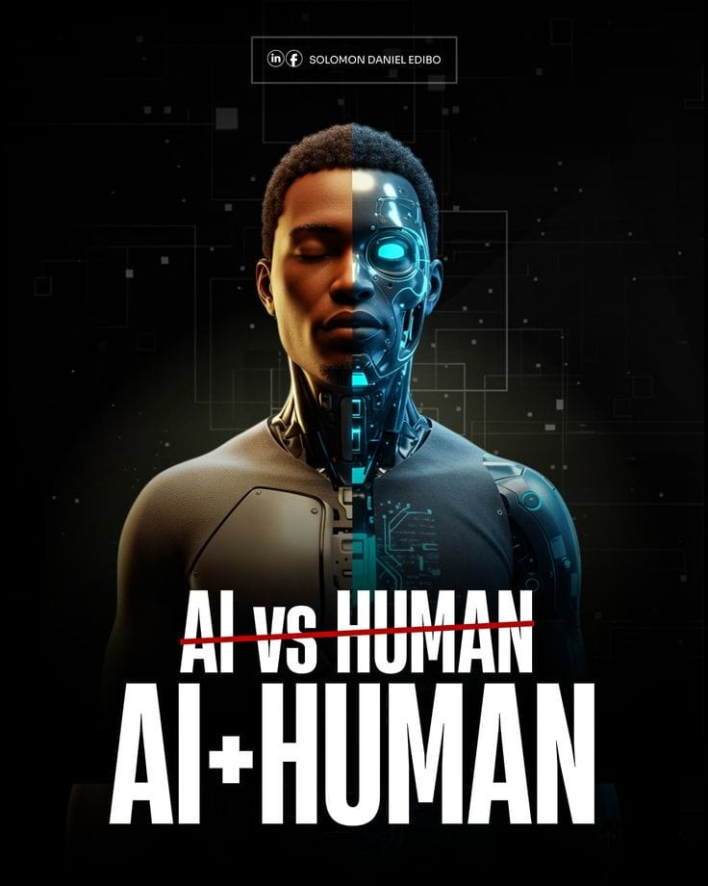
CONCLUSION
“AI has evolved from imagination to reality and is shaping the future of humanity. AI is not just a technology, It is a new era of human evolution”
“ AI is changing the world faster than any invention in history.”
“Artificial intelligence is the new electricity.”
“ This is not the future… this is happening now.”

Slide 13
References:
Artificial Intelligence: A Modern Approach- by Stuart Russell & Peter Norvig
Life 3.0- by Max Teg Mark
AI for Everyone- by Andrew NG
AI Material from :
- NCERT (ICT/AI Modules)
- CBSE AI curriculum
Image Sources:
www.google.com
www.pinterest.com

Slide 14


